Slide 1
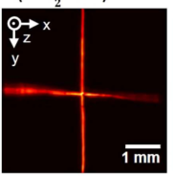
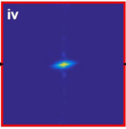
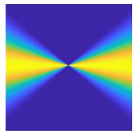
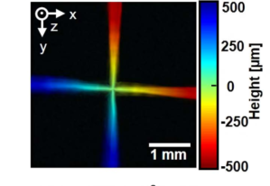
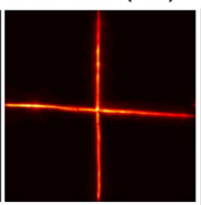
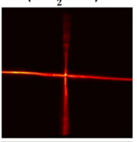
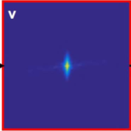
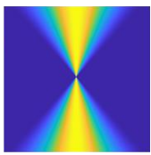
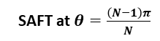
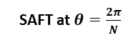
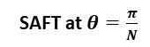
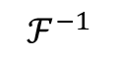
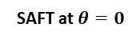
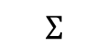
2D Directional SAFT Scheme
Stage A:
Stage B:
Stage C:
Stage D:
Stage E:
Extract Improved Frequencies
Fourier Transform
X
SAFT at $θ=0$
SAFT at $θ=\frac{π}{N}$
.
.
.
Inverse Fourier
.
.
.
.
.
.
.
.
.
.
.
.
$$Σ$$
$$ℱ^{−1}$$
SAFT at $θ=\frac{2π}{N}$
.
.
.
X
.
.
.
SAFT at $θ=\frac{\left(N−1\right)π}{N}$
.
.
.
.
.
.

Slide 2
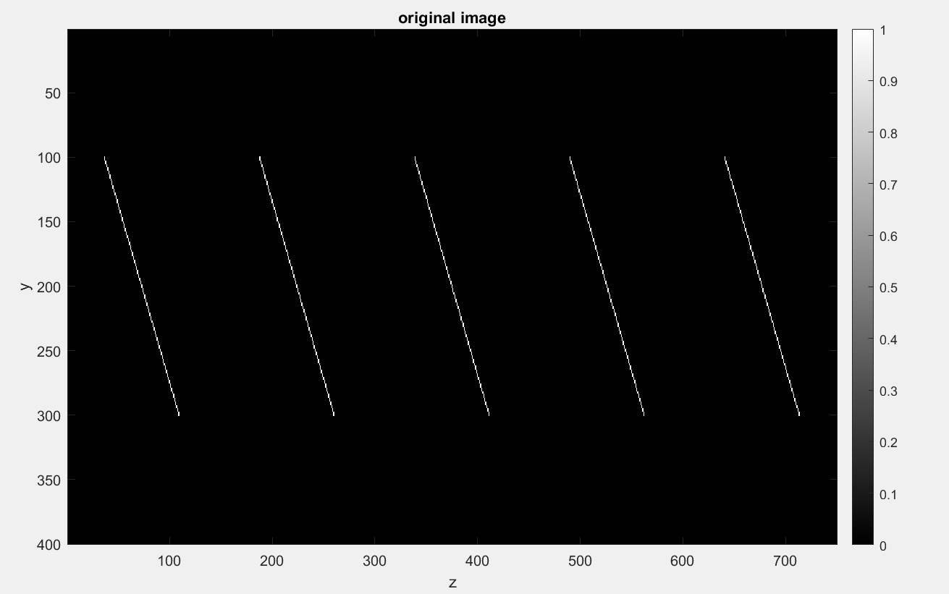
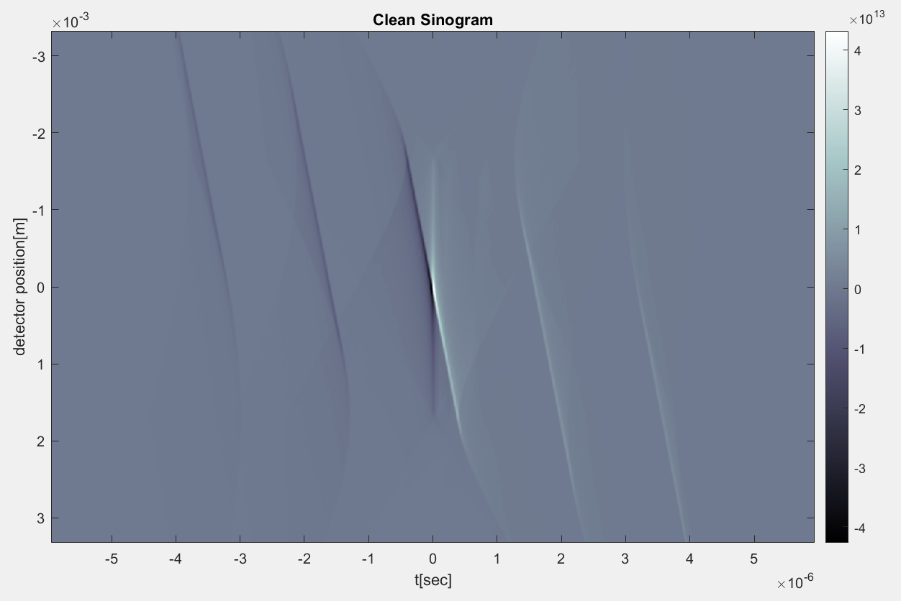
2D Scan

Slide 3
Y Scan and X Scan
Transducer
y
y
Transducer
x
z
x
x-scan
z
y-scan
(a)
(b)

Slide 4
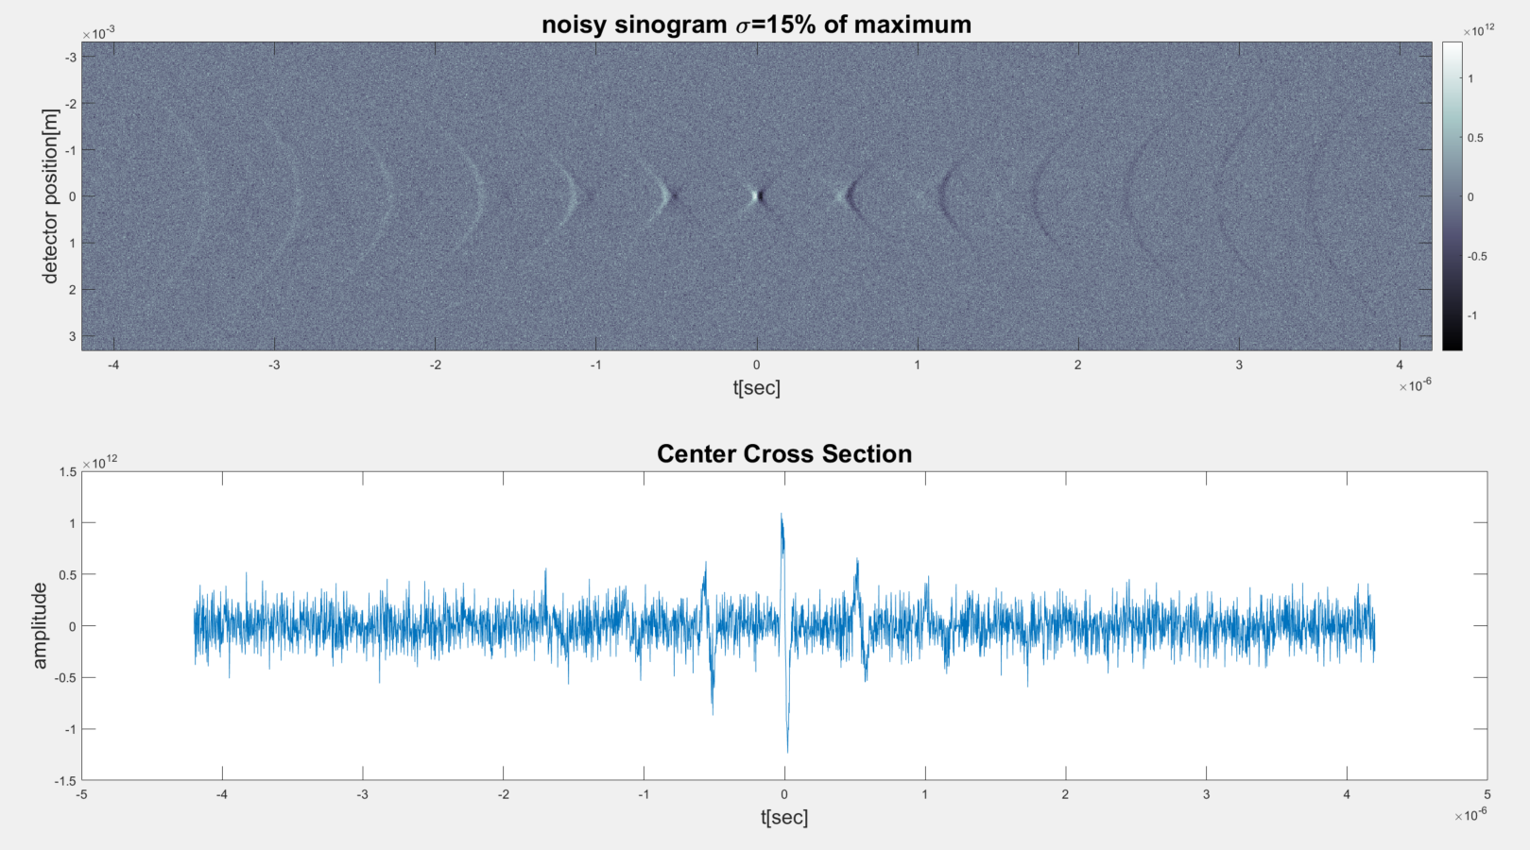
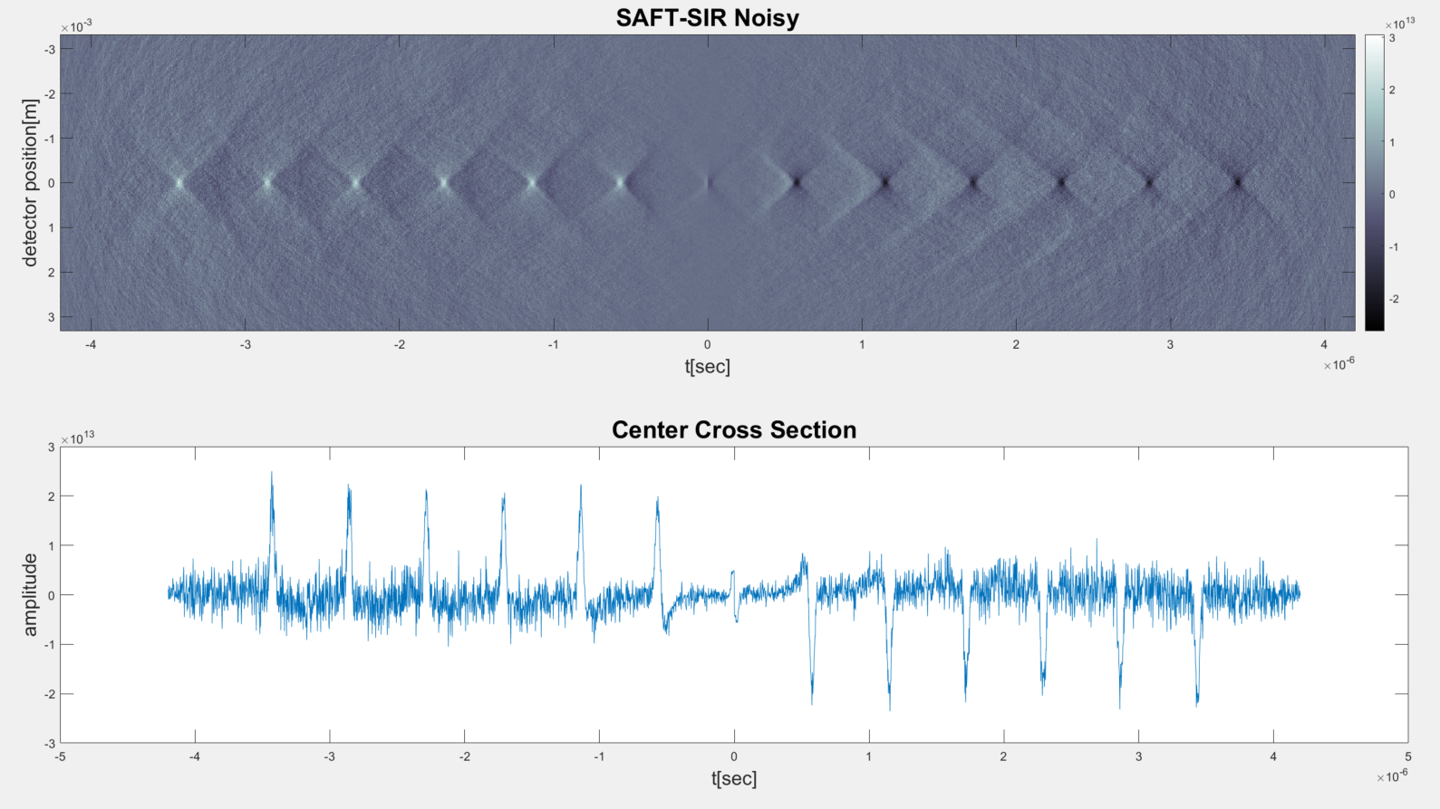
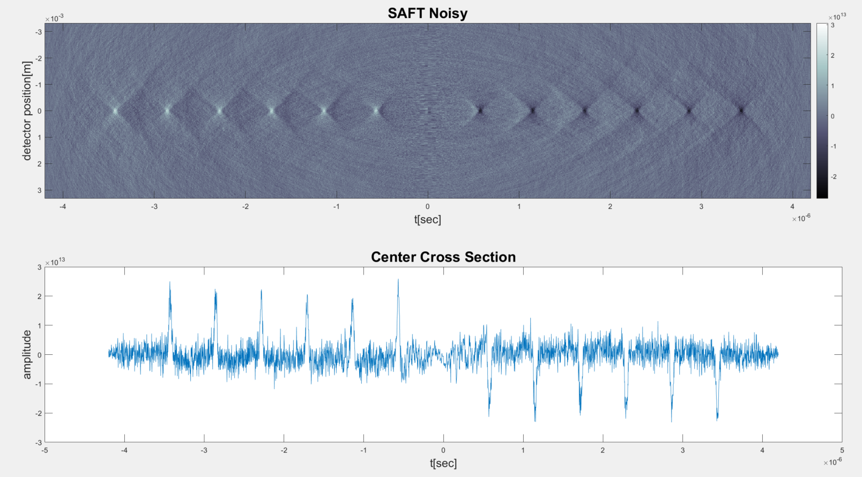
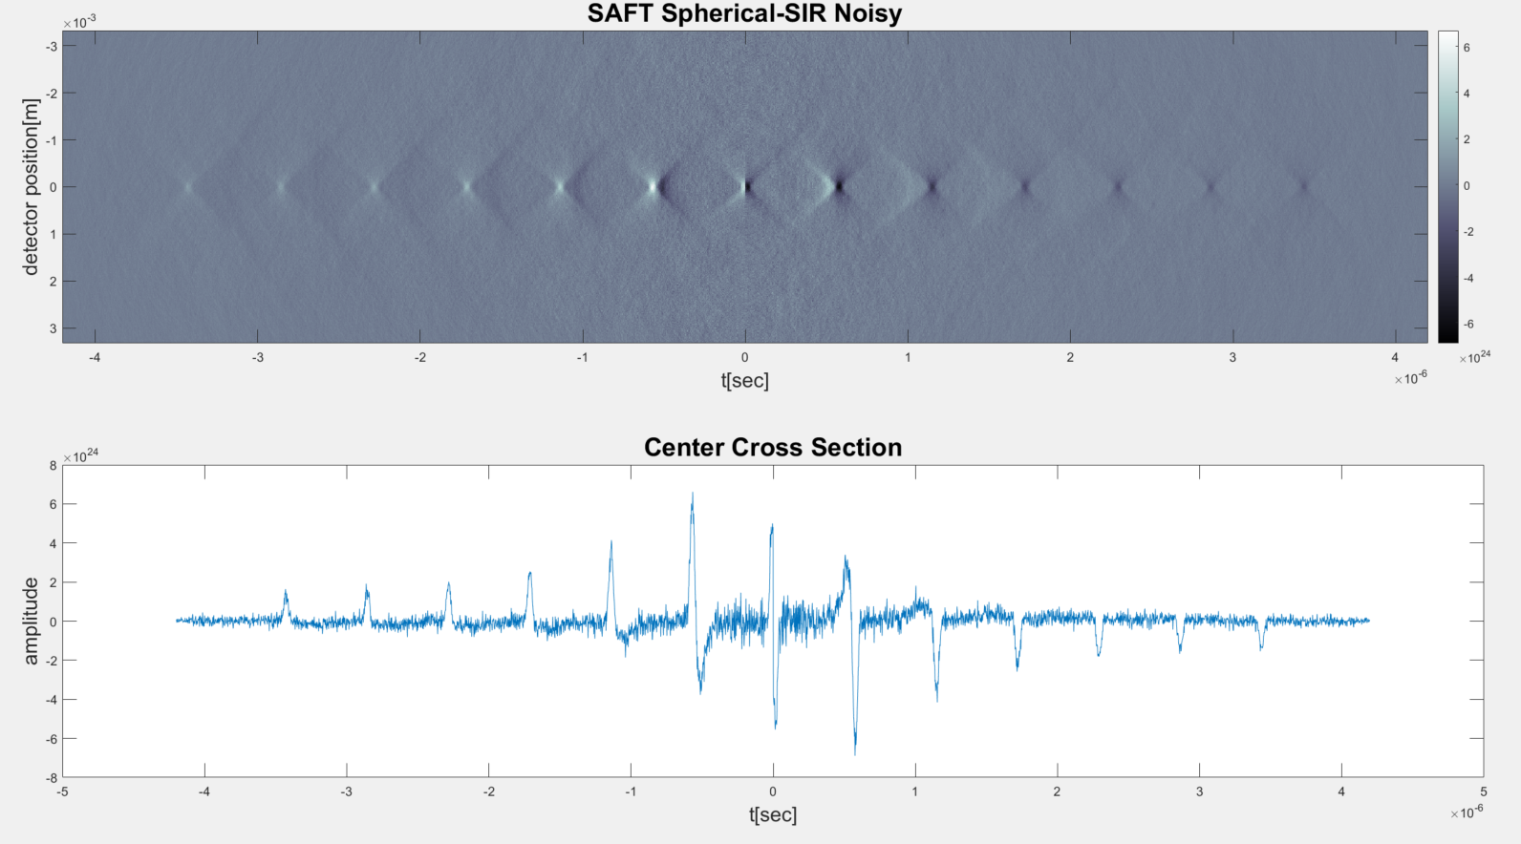
Points SAFT Performance
(a)
(c)
(b)
(d)

Slide 5
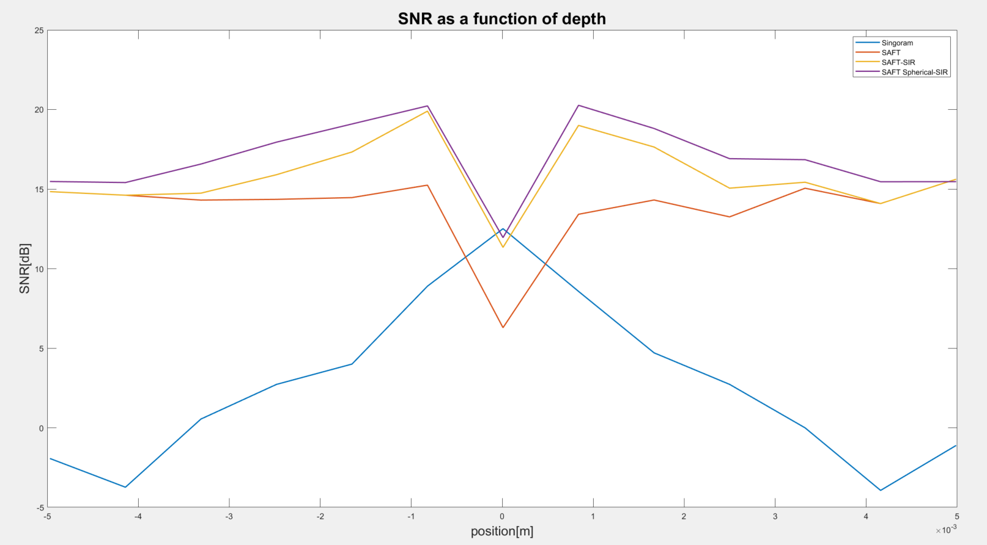
SNR and FWHM for spaced points

Slide 6
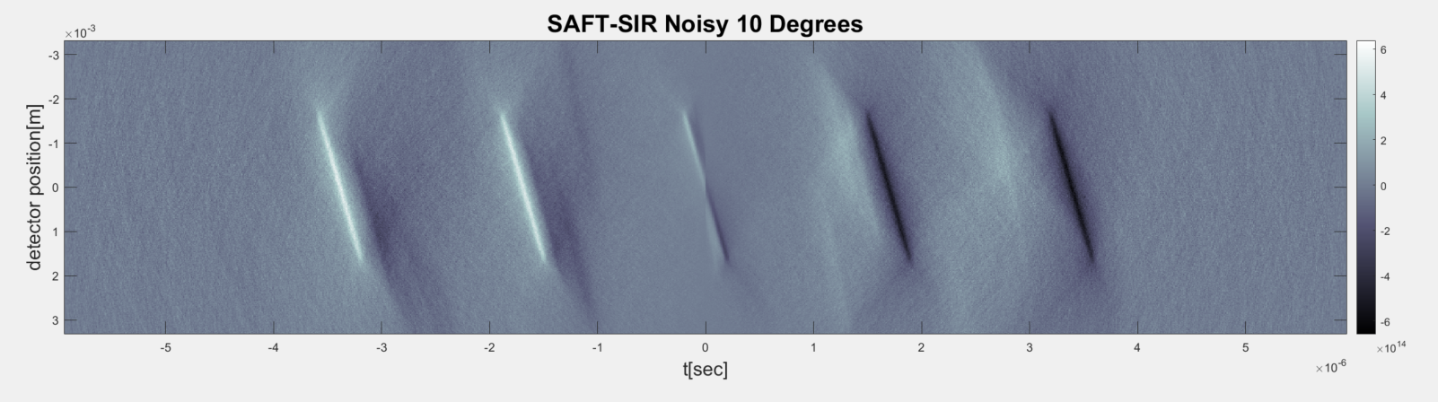
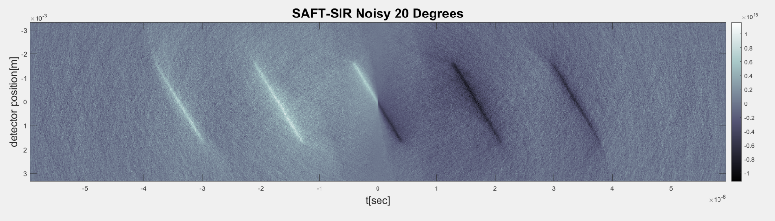

2D Angled Lines at different angles
(a)
(b)
(c)

Slide 7
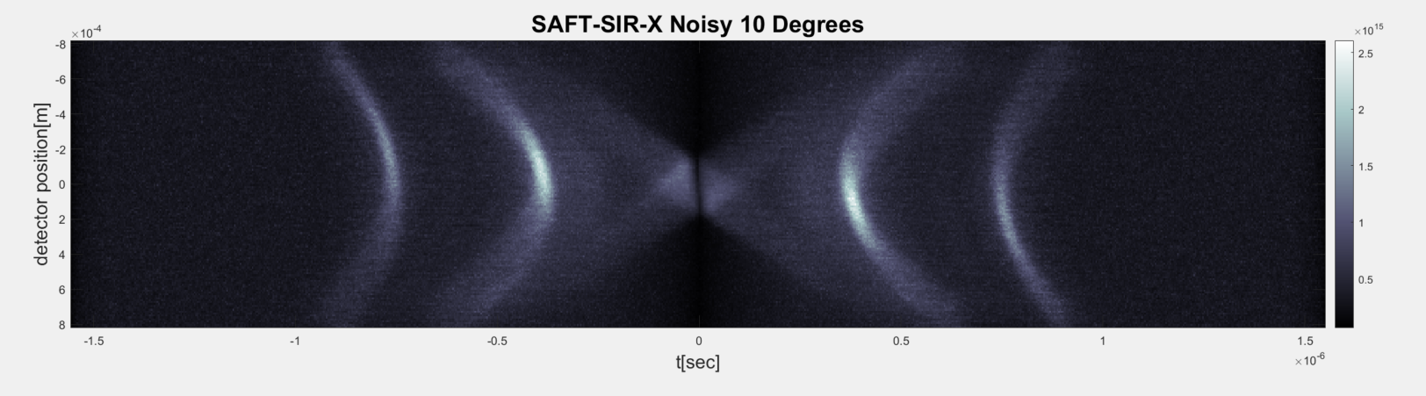
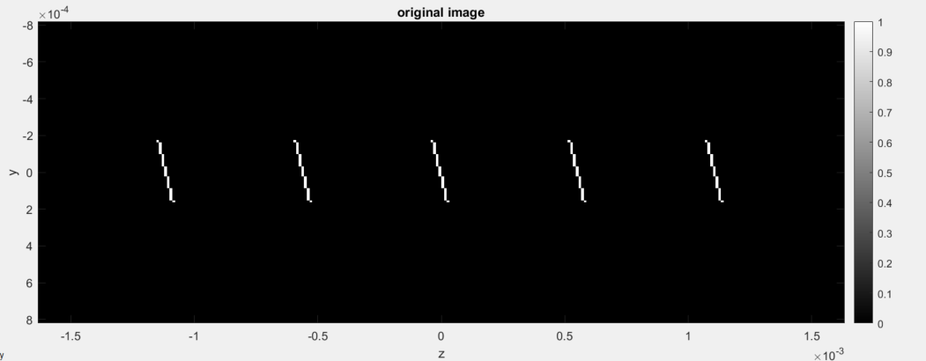
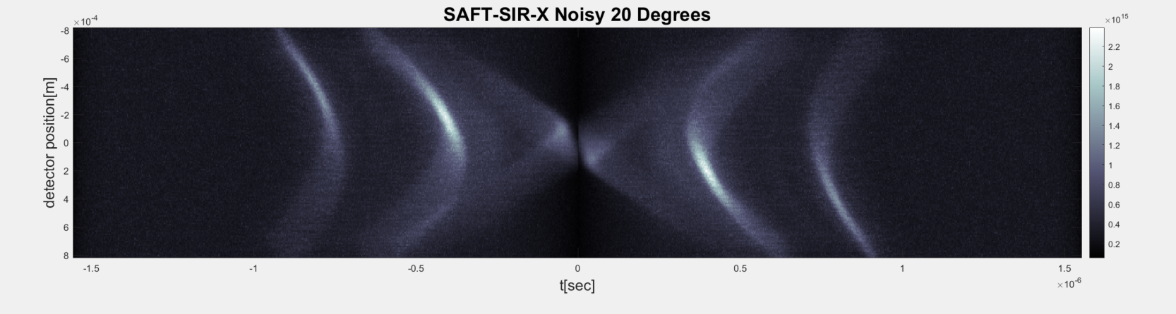
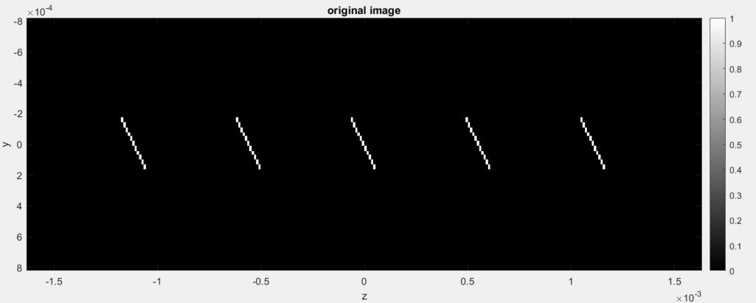
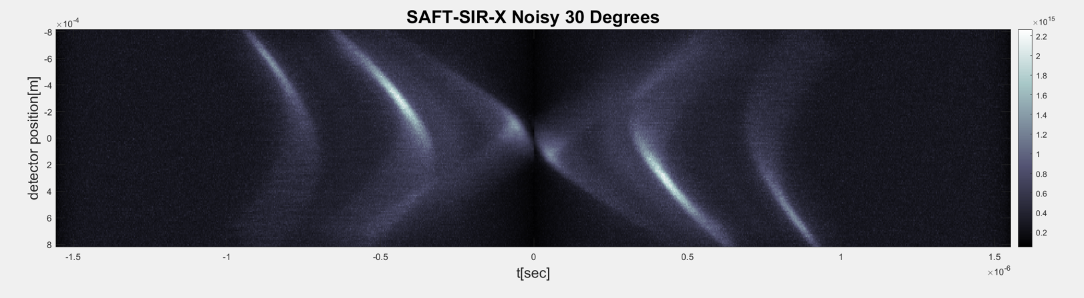
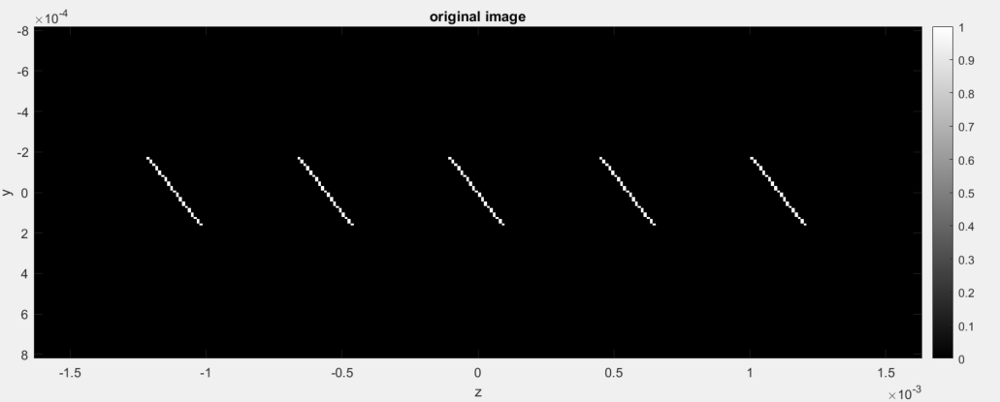
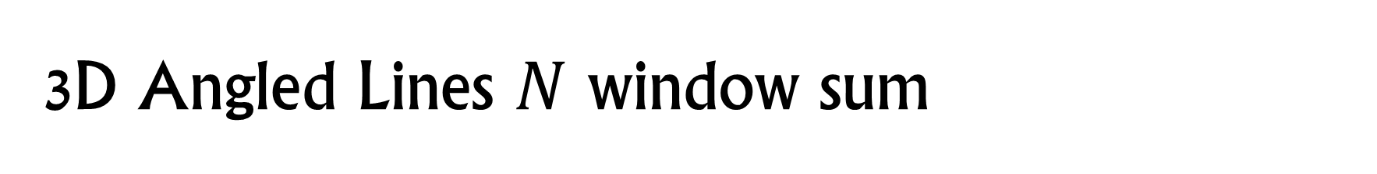
3D Angled Lines $N$ window sum
(a)
(b)
(c)

Slide 8
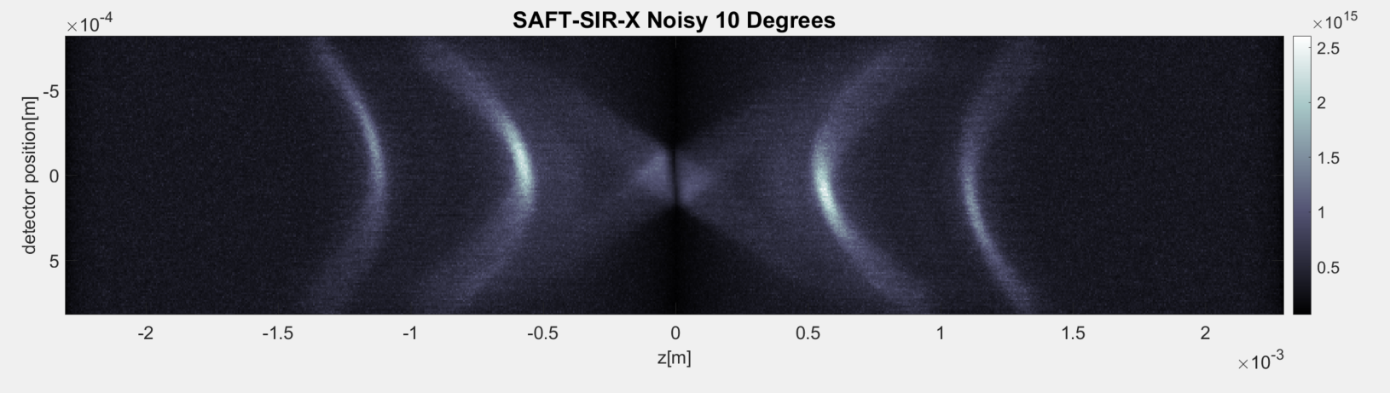
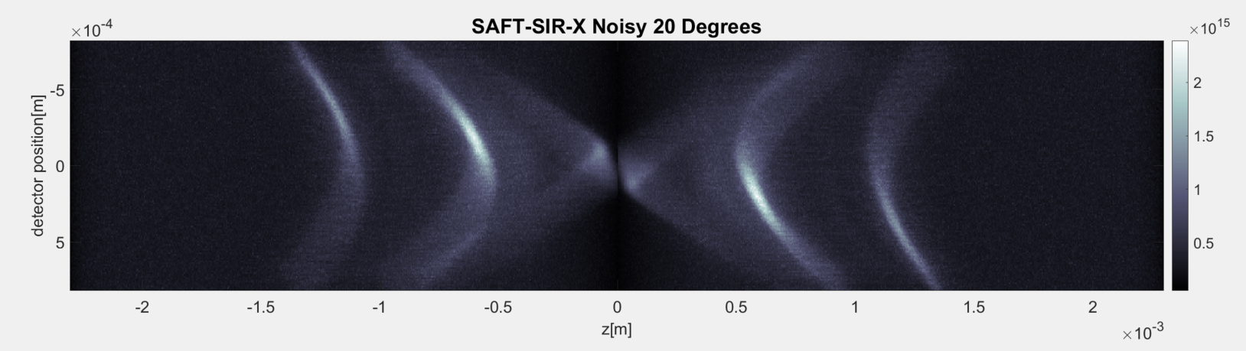
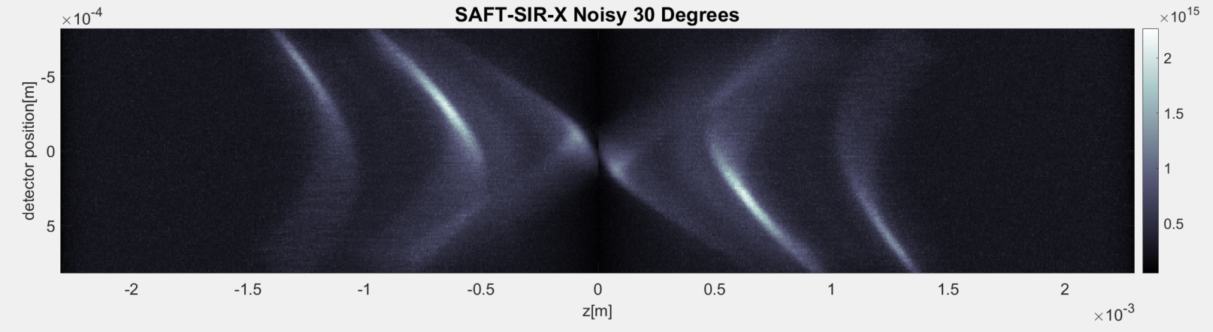
3D Angled Lines $N$ window sum
(a)
(b)
(c)

Slide 9
3D Angled Lines $N$ window sum
(a)
(b)
(c)

Slide 10
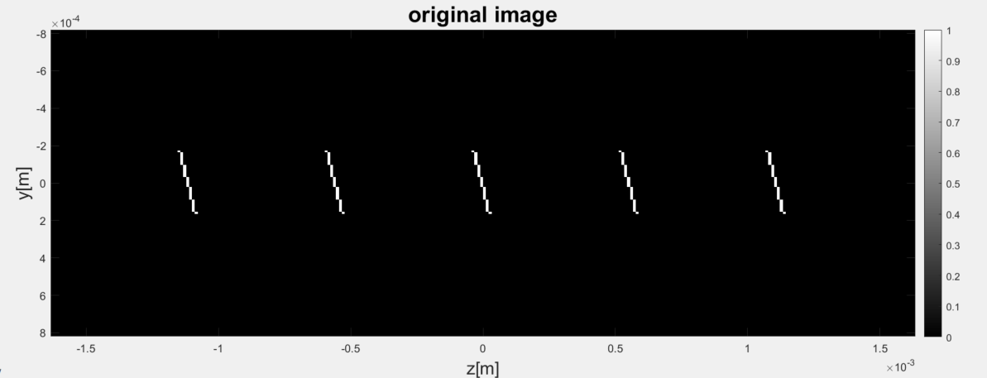
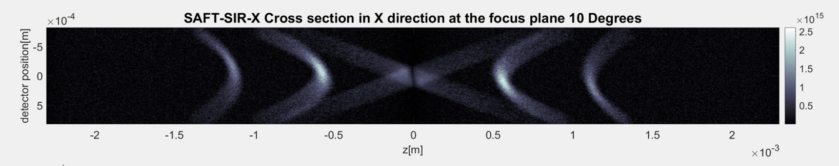
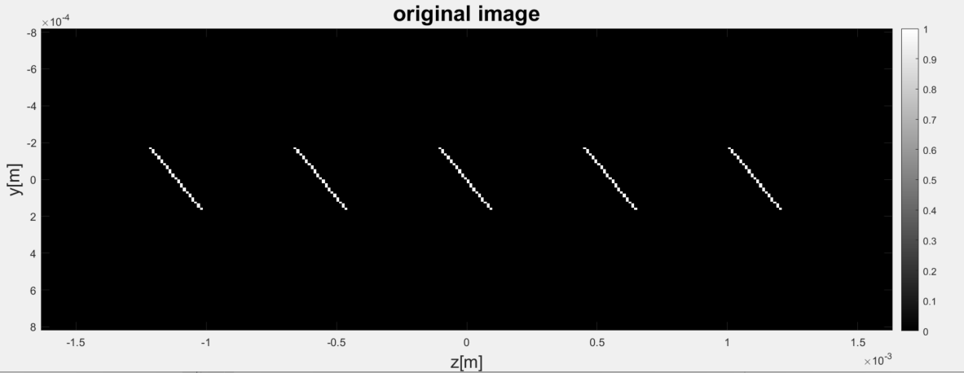
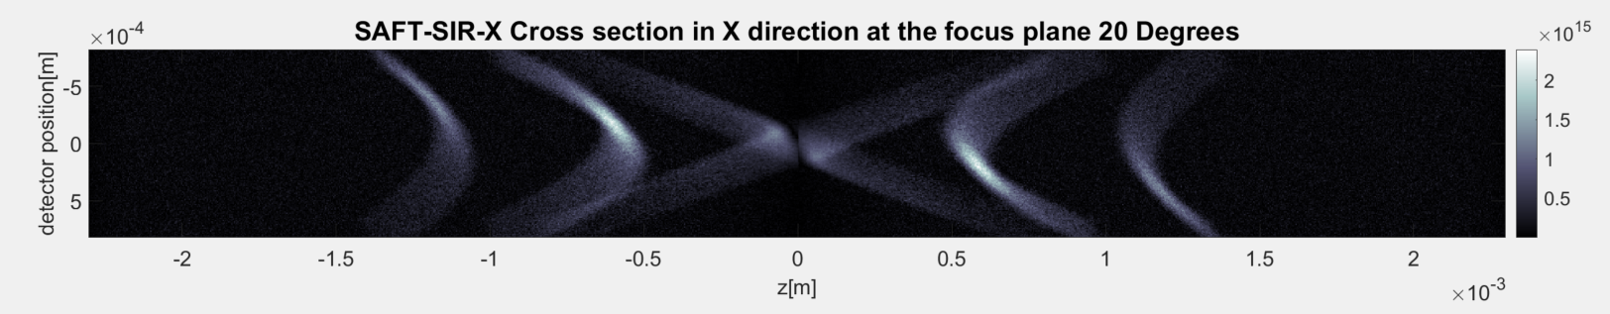
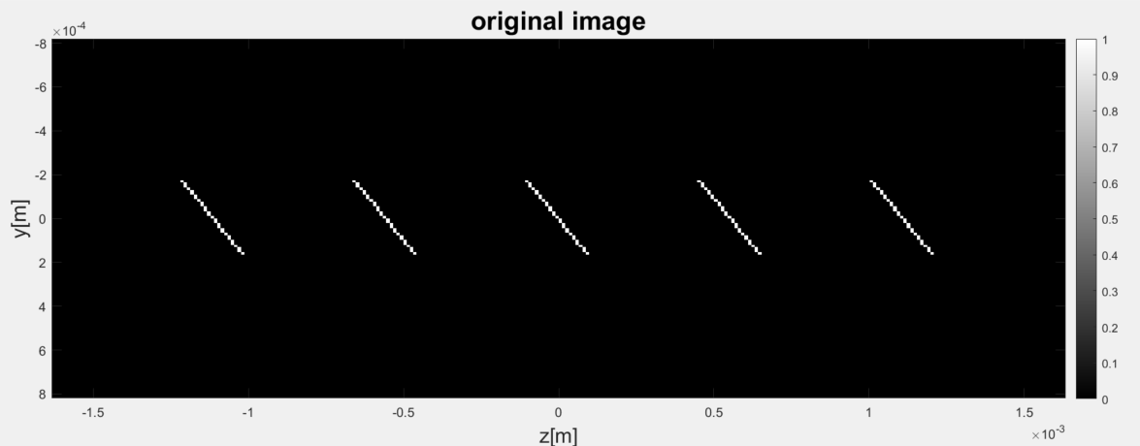
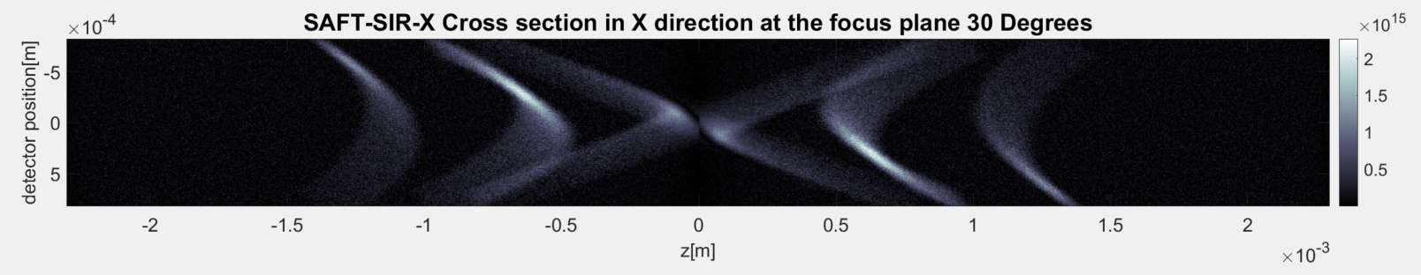
Angled lines Cross sections
(a)
(d)
(b)
(e)
(c)
(f)

Slide 11
Angled lines Cross sections
(a)
(d)
(b)
(e)
(c)
(f)

Slide 12
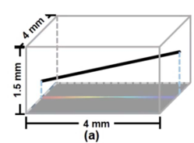
System sketch
y
x
z
SAFT Sum Direction (x)

Slide 13
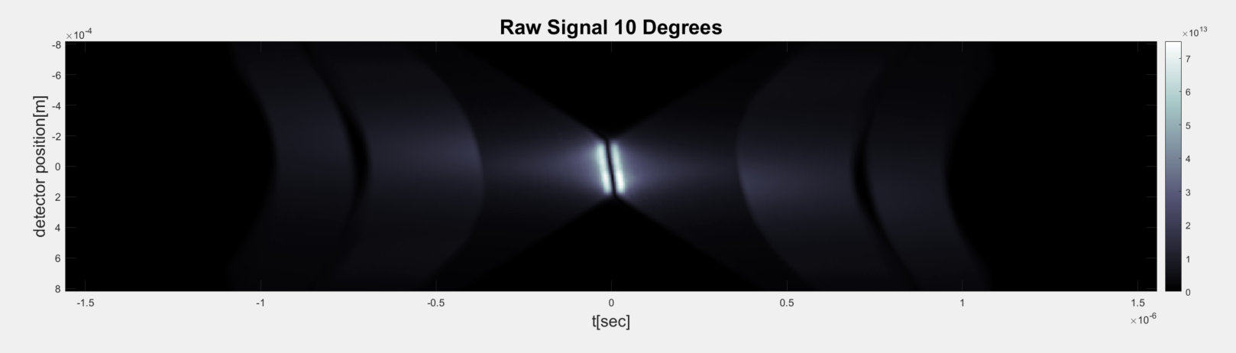
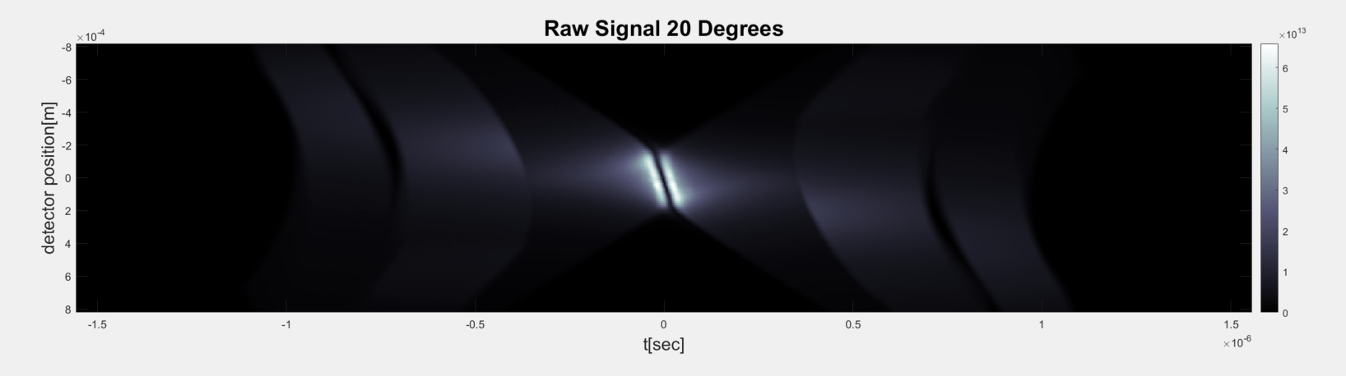
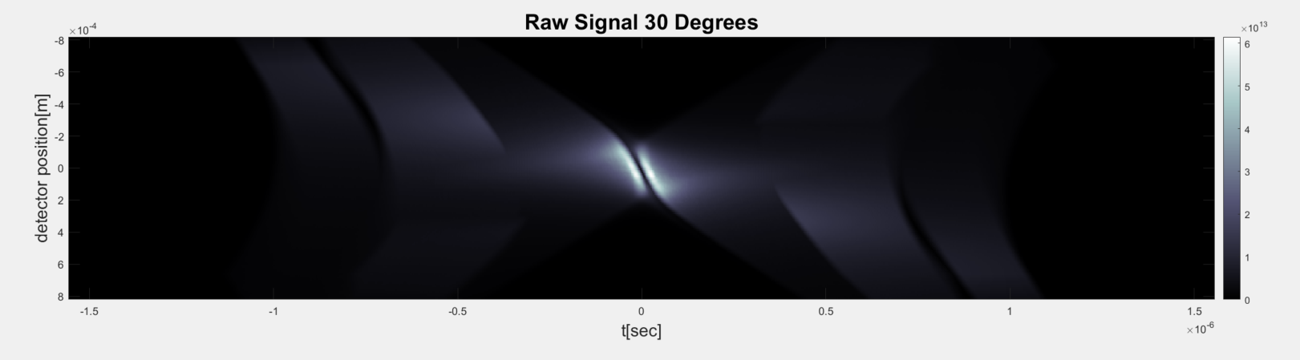
3D Angled Lines Raw Signals
(a)
(b)
(c)

Slide 14
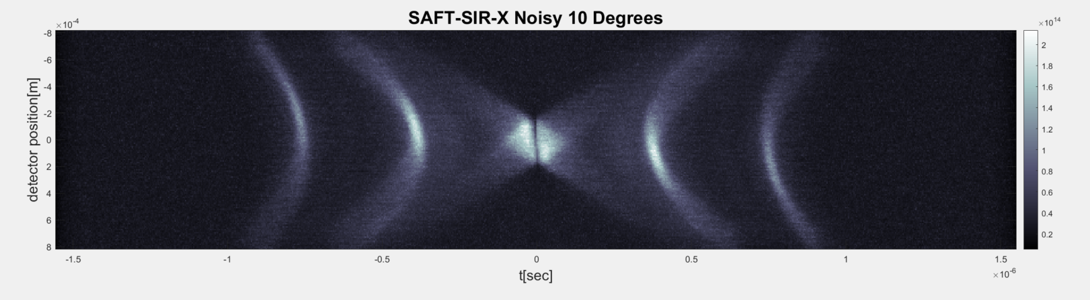

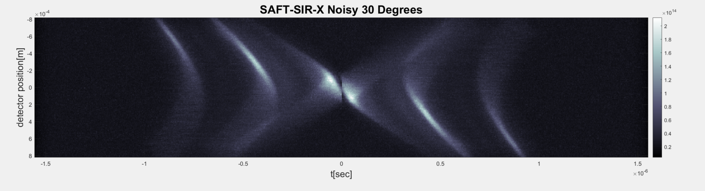
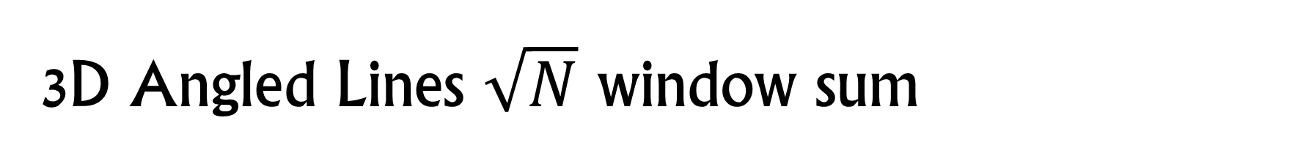
3D Angled Lines $\sqrt{N}$ window sum
(a)
(b)
(c)

Slide 15
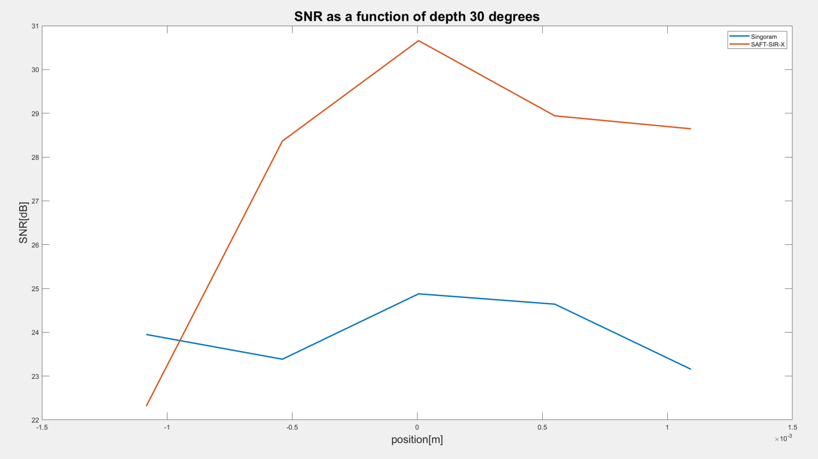
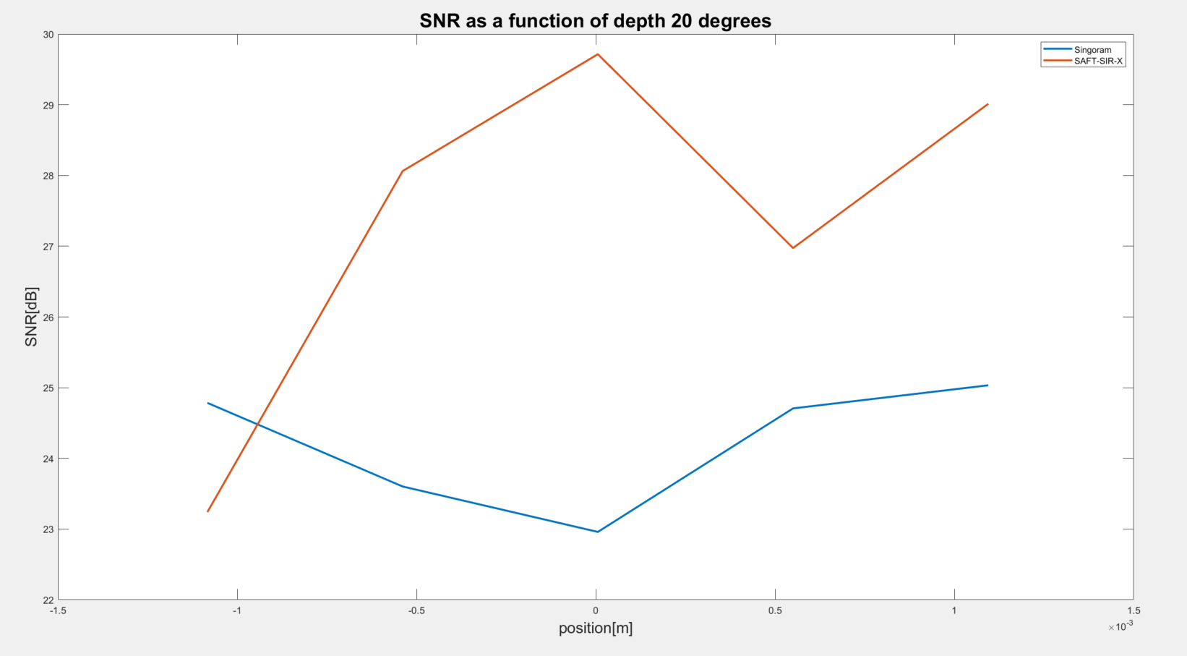
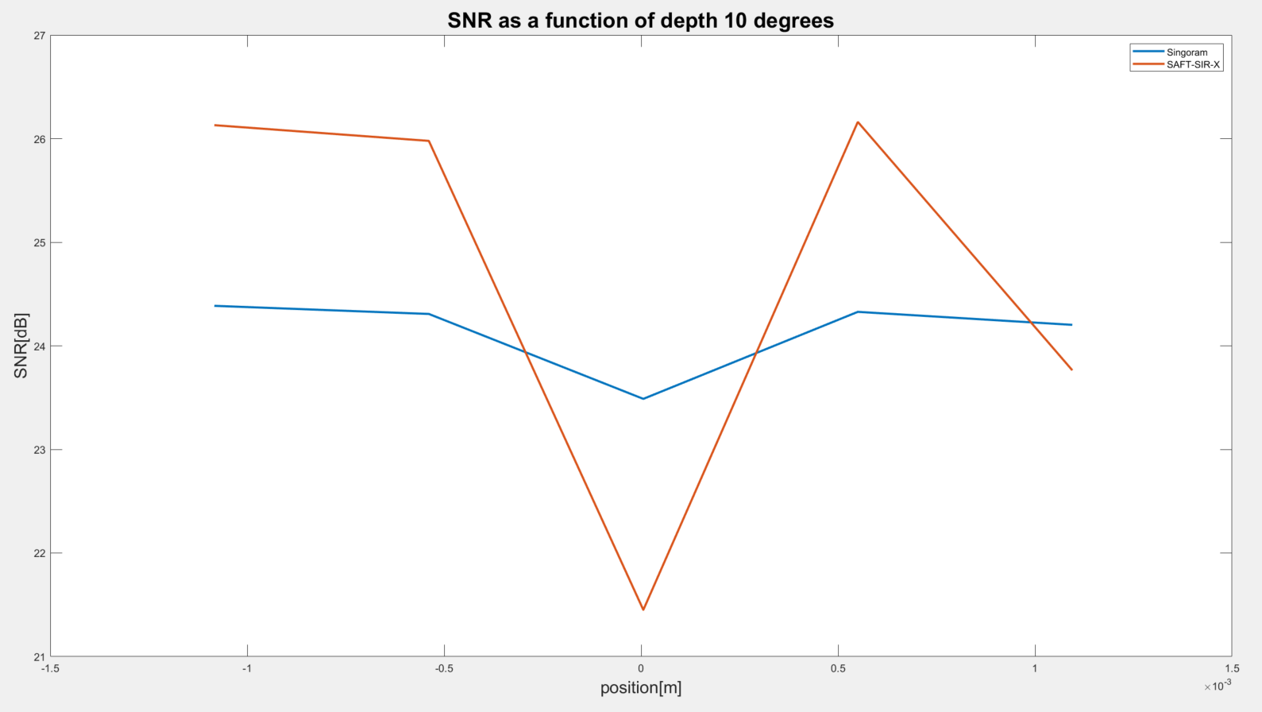
SNR in 3D

Slide 16
Angled lines Scan Illustration
Transducer
y
y
Transducer
x
z
x
x-scan
y-scan
z
(a)
(b)

Slide 17
Lateral displacement of angled lines
Transducer

Slide 18
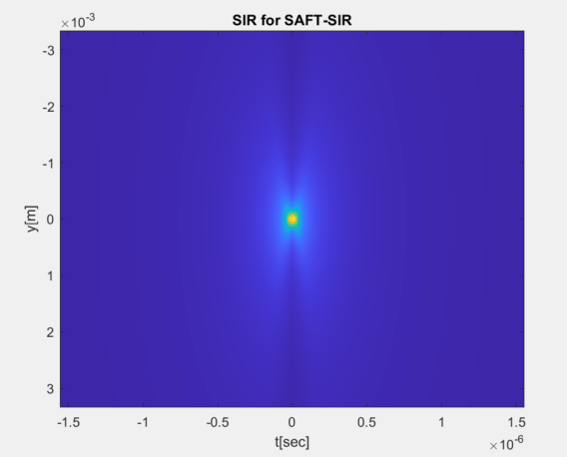
SIR

Slide 19





Points SAFT in 3D

Slide 20


Cross sections for line at zero angle

Slide 21

Raw Data Cross sections zero angle

Slide 22


Cross sections for line at 10 angle

Slide 23


Cross sections for line at 20 angle

Slide 24

Raw Data Cross Sections 20 Degrees

Slide 25



Raw Signals for Angled lines
(a)
0 Degree line
(b)
10 Degree line
(c)
20 Degree line
y
x
z

Slide 26


Cross sections for line at 30 degrees angle

Slide 27

Depth MAP for 20 degrees line

Slide 28

Depth MAP for 0 degrees angle

Slide 29

Paper Experiment Repeated – X MAP

Slide 30

Paper Experiment Repeated – Z MAP

Slide 31

Paper Experiment– Z MAP Displacement Test

Slide 32


Paper Experiment 14 Degrees
(a)
(b)
(i)
(ii)
(iii)
(iv)

Slide 33

Paper Experiment 30 Degrees – X MAP

Slide 34


Paper Experiment 14 Degrees
(a)
(b)
(i)
(ii)
(iii)

Slide 35
Scenario Depth Angle Affects Reconstruction
Transducer
Imaged well
y
x
z
Imaged poorly
Imaged poorly

Slide 36


Knot Experiment
(d) Object Photograph

